Slide 1
MIS 7720 Business Artificial Intelligence

Slide 2
MIS 7720 #1 Introduction

Slide 3
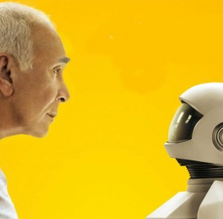
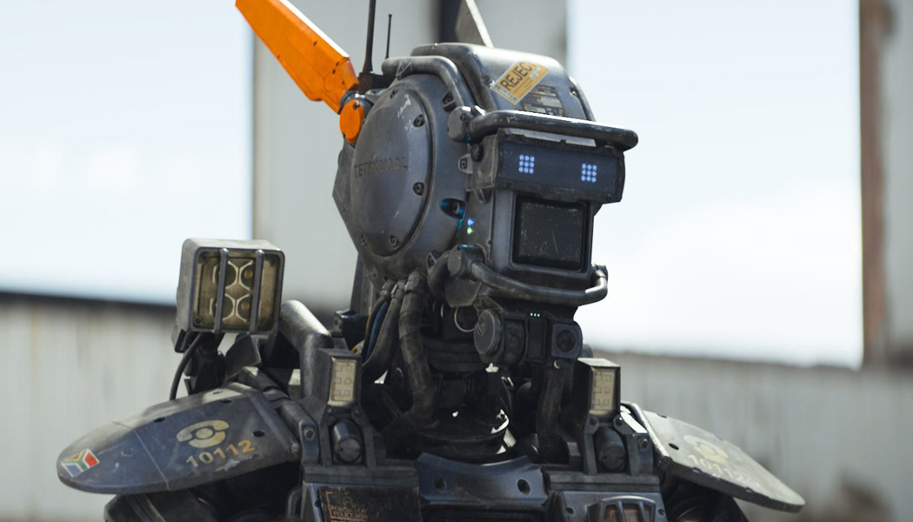
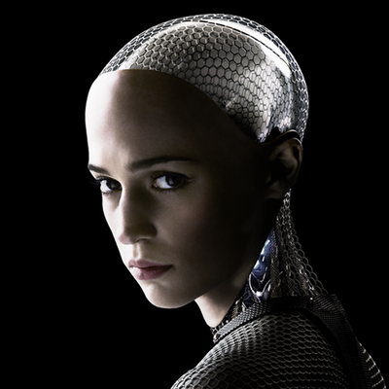
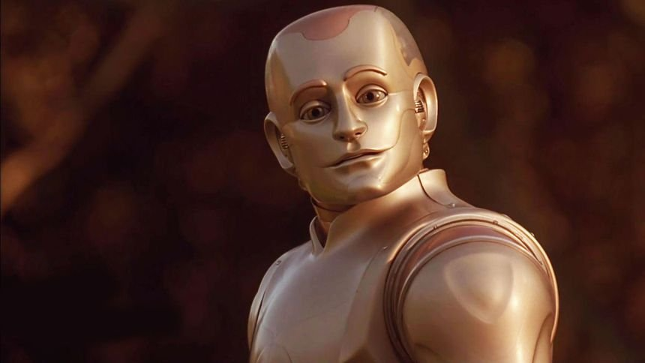

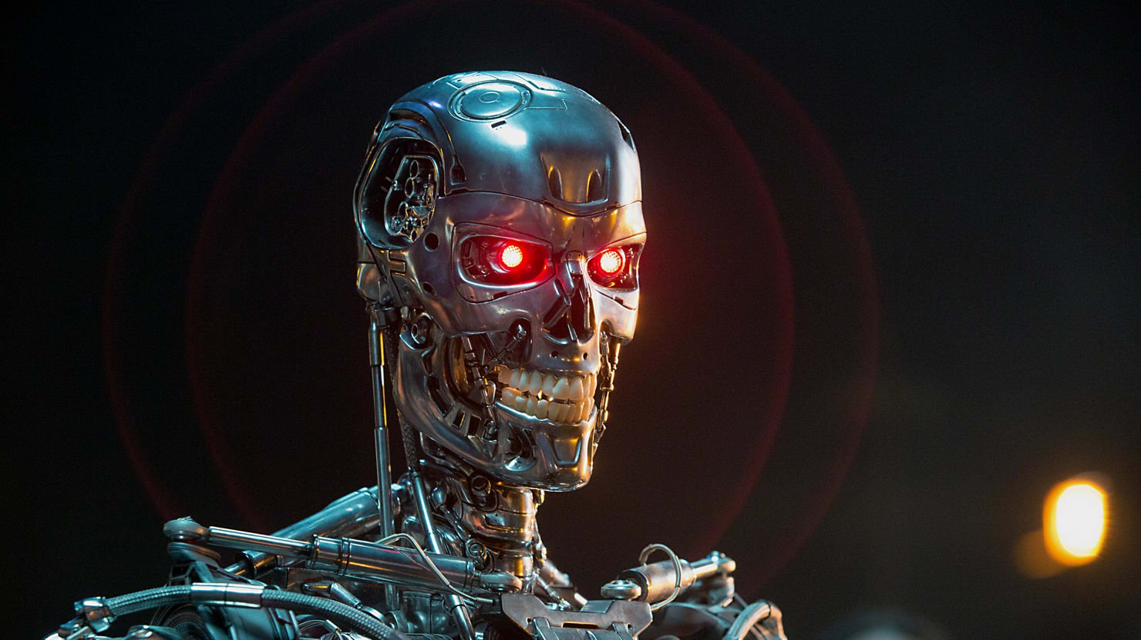
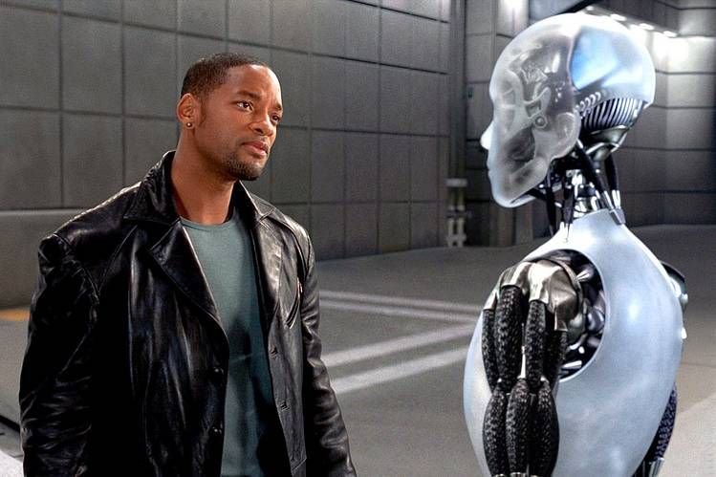
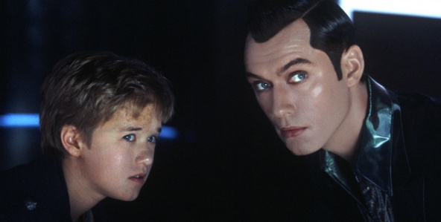

Sci-Fi AI…
Notes:
Ex machina
Robot and Frank
A.I. Artificial Intelligence
Bicentennial man 1999
Terminator
Chappie
I, Robot
Wall e
Big Hero

Slide 4
What is Artificial Intelligence?
The science of making machines/systems that…
Think like humans
Act like humans
Think rationally
Act rationally
Notes:
https://en.wikipedia.org/wiki/Turing_test

Slide 5
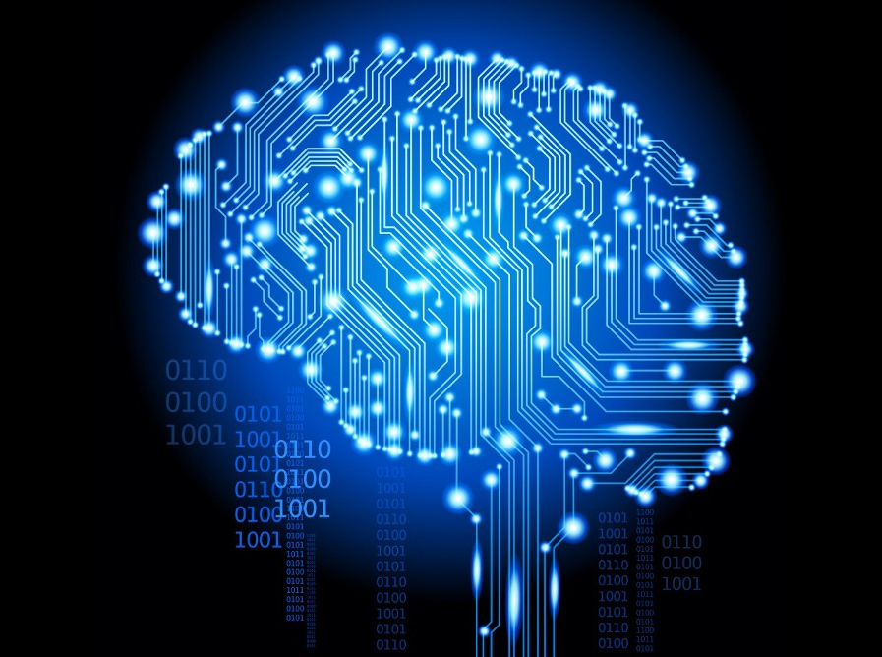
Thinking like humans
The 1960s “cognitive revolution” replaced prevailing behaviorism with information-processing psychology.
Cognitive Science, Cognitive Neuroscience
Both approaches are distinct from AI but share similar characteristic:
The available theories do not explain anything resembling human-level general intelligence
Notes:
The cognitive modeling approach

Slide 6
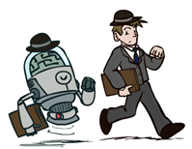

Acting like humans
Can machines think? → Can machines behave intelligently?
An operational test for intelligent behavior: Turing test, dating back to Alan Turing (1950)
Player C, the interrogator, is given the task of trying to determine which player – A or B – is a computer and which is a human. The interrogator is limited to using the responses to written questions to make the determination
Suggested major components of AI: knowledge, reasoning, language understanding, learning
Notes:
The Turing test approach
Imitation Game

Slide 7
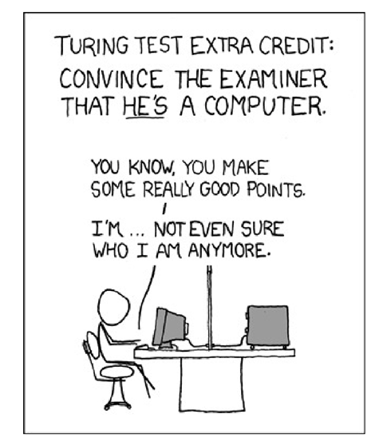

Slide 8

Thinking rationally
Normative (or prescriptive) rather than descriptive
What are correct arguments/thought processes?
Direct line through math and philosophy to modern AI
Problems:
Not all intelligent behavior is mediated by logical deliberation
What is the purpose of thinking?
What actually matters are the actions
Notes:
The “laws of thought” approach

Slide 9
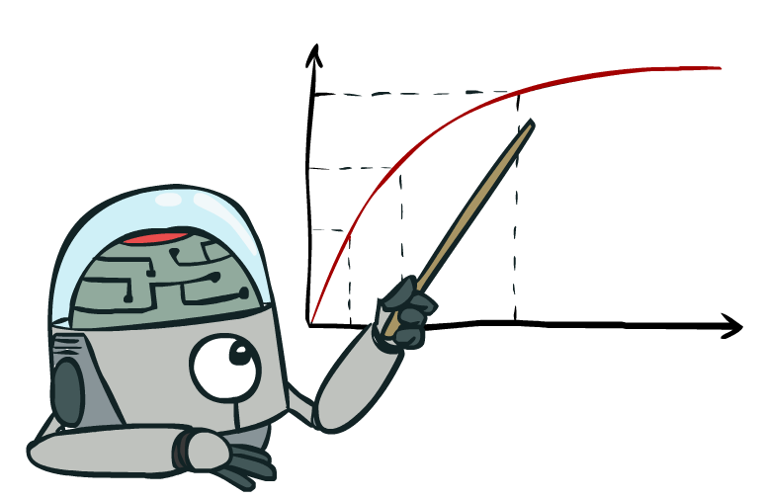
Acting Rationally
We will use it in a specific way…
Rational: maximally achieving pre-defined goals
Rationality only concerns what decisions are made (not the thought process behind them)
Goals are expected in terms of the utility of outcomes
Being rational means maximizing your expected utility
How to build machines that maximize expected utility
Notes:
The rational agent approach

Slide 10
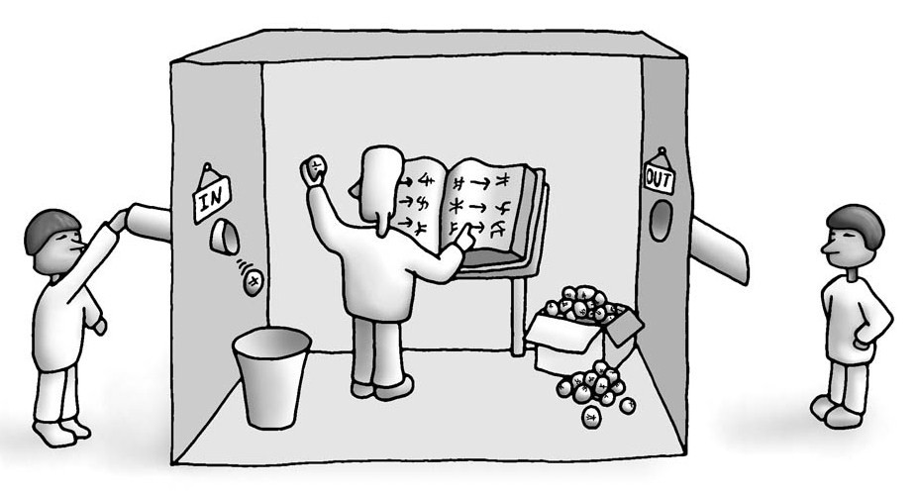
The Chinese room thought experiment
Notes:
How is thinking rationally different from acting rationally? I can have the perfect recipe to play tic-tac-toe and hard-code those rules, following them would demonstrate rational game-play even though there is no rational thinking.
Searle, J. (1980). Minds, brains, and programs. Behavioral and Brain Sciences, 3(3), 417-424.
https://doi.org/10.1017/S0140525X00005756
Consciousness vs. the simulation of consciousness
… Turing test is insufficient to detect the presence of consciousness, even if the room can behave or function as a conscious mind would.

Slide 11
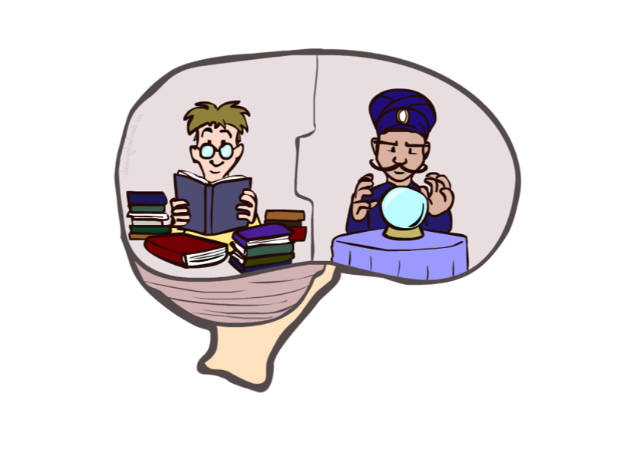
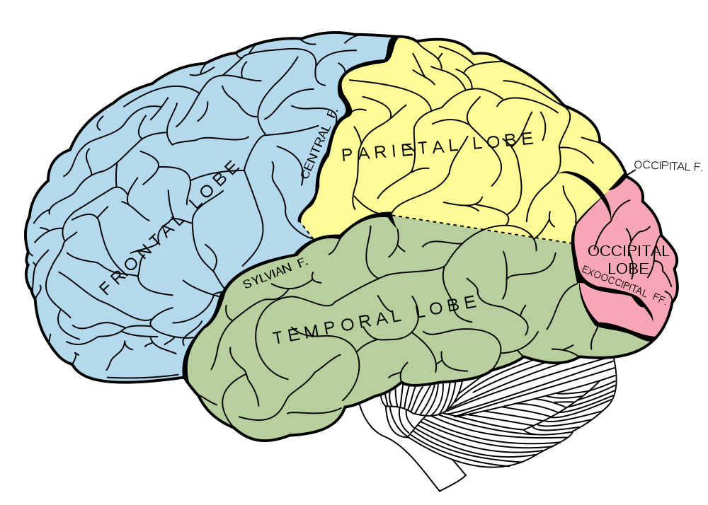
Not trying to build a brain
Very hard to understand (not there yet)
Brains (human minds) are very good at making rational decisions, but not perfect
Brains aren’t as modular as software, so hard to reverse engineer!
“Brains are to intelligence as wings are to flight”
Lessons learned from the brain: memory and simulation are key to decision making
Notes:
Planes don’t flap their wings like birds do!

Slide 12
Early days: 1940 – 50
1942: Asimov: Positronic Brain; Three Laws of Robotics
A robot may not injure a human being or, through inaction, allow a human being to come to harm.
A robot must obey the orders given to it by human beings, except where such orders would conflict with the First Law.
A robot must protect its own existence as long as such protection does not conflict with the First or Second Laws.
1943: McCulloch & Pitts: Boolean circuit model of brain
1946: First digital computer – ENIAC
1950: Turing's “Computing Machinery and Intelligence”
Notes:
Symbolic AI: collection of all methods in AI that are based on high-level "symbolic" (human-readable) representations of problems, logic and search.

Slide 13
Excitement: 1950 – 70
1950s: Early AI programs, including
Samuel's checkers program
Newell & Simon's Logic Theorist
Gelernter's Geometry Engine
1956: Dartmouth meeting: “Artificial Intelligence” adopted
1965: Robinson's complete algorithm for logical reasoning
Notes:
Symbolic AI: collection of all methods in AI that are based on high-level "symbolic" (human-readable) representations of problems, logic and search.

Slide 14
Knowledge based approaches: 1970 – 80
1969—79: Early development of knowledge-based systems
The knowledge engineer practices the art of bringing the principles and tools of AI research to bear on difficult applications problems requiring experts’ knowledge for their solution.
- Edward A. Felgenbaum, “The art of artificial intelligence”
1980—88: Expert systems industry booms
1988—93: Expert systems industry busts: “AI Winter”
Notes:
Symbolic AI: collection of all methods in AI that are based on high-level "symbolic" (human-readable) representations of problems, logic and search.

Slide 15
Statistical approaches: 1988
1985-1990: Rise of Probability and Decision Theory
Adopted sophisticated mathematical tools, such as hidden Markov models, information theory, and normative Bayesian decision theory; e.g. Bayesian Networks
Judea Pearl - ACM Turing Award 2011
1990-2000: Machine learning takes over subfields
Vision, Natural language, etc.
Gary Kasparov wins deep blue 1996, loses in 1997 rematch
2000 – : Where are we now?
Notes:
Sub symbolic AI: Sub-symbolic methods manage to approach intelligence without specific representations of knowledge.
1996 Kasparov
http://content.time.com/time/subscriber/article/0,33009,984305-1,00.html
1997 Kasparov

Slide 16
History of AI
Thinking machines 1960: https://www.youtube.com/watch?v=aygSMgK3BEM

Slide 17
Integrating approaches
Intelligent agents
An intelligent agent is a system that perceives its environment and takes actions which maximize its chances of success.
The simplest intelligent agents are programs that solve specific problems.
More complicated agents include human beings and organizations of human beings (such as firms).
We will come back to this, let’s first take a look at some examples…

Slide 18
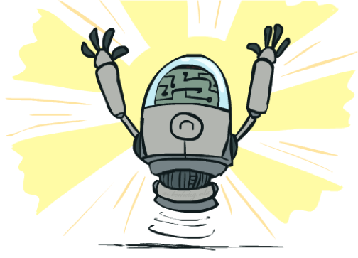
Which of the following can be done today?
Play a decent game of table tennis?
Drive safely along a curving mountain road?
Drive safely in a downtown New York?
Buy a week's worth of groceries on the web?
Buy a week's worth of groceries at a busy Farmer’s market?
Play a decent game of bridge?
Discover and prove a new mathematical theorem?
Design and execute a research program in molecular biology?
Write an intentionally funny story?
Give competent legal advice in a specialized area of law?
Translate spoken English into spoken Chinese in real time?
Converse successfully with another person for an hour?
Perform a complex surgical operation?
Unload any dishwasher and put everything away?
Notes:
https://www.businessinsider.com/artificial-intelligence-ai-most-impressive-achievements-2017-3
https://www.forbes.com/sites/bernardmarr/2019/11/11/13-mind-blowing-things-artificial-intelligence-can-already-do-today

Slide 19
Unintentionally funny stories
Shank, Talespin System, 1984
One day Joe Bear was hungry. He asked his friend Irving Bird where some honey was. Irving told him there was a beehive in the oak tree. Joe walked to the oak tree. He ate the beehive. The End.
Henry Squirrel was thirsty. He walked over to the river bank where his good friend Bill Bird was sitting. Henry slipped and fell in the river. Gravity drowned. The End.
Once upon a time there was a dishonest fox and a vain crow. One day the crow was sitting in his tree, holding a piece of cheese in his mouth. He noticed that he was holding the piece of cheese. He became hungry, and swallowed the cheese. The fox walked over to the crow. The End.
Notes:
https://www.cs.utah.edu/nlp/papers/talespin-ijcai77.pdf
1 – physically wrong, shouldn’t eat beehive
2 – forgot that in drowning not the force is most important but the drownee
3 – not physically wrong, not wrong in a language way, but wrong in the sense that it’s not aware of what is relevant to communicate and what is not
DEMO: try google assistant and/or Siri in class

Slide 20
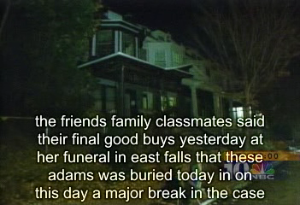
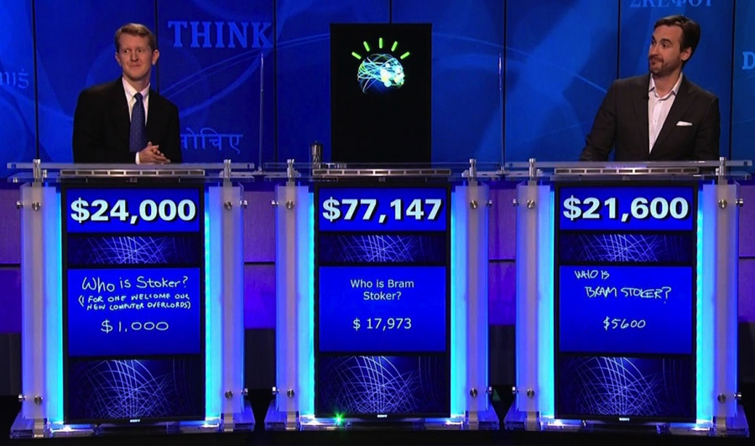
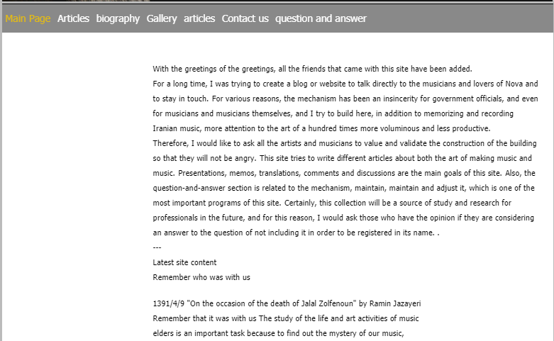
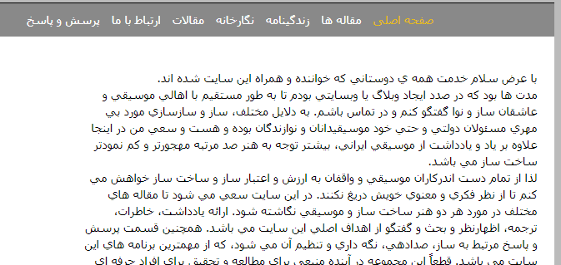
Natural Language
Speech technologies (e.g. Siri)
Automatic speech recognition (ASR)
Text-to-speech synthesis (TTS)
Dialog systems
Language processing technologies
Question answering
Machine translation
Web search
Text classification, spam filtering, etc…

Slide 21


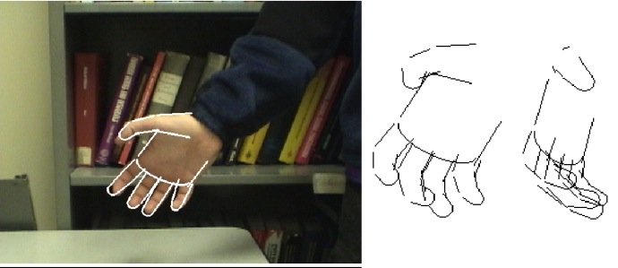
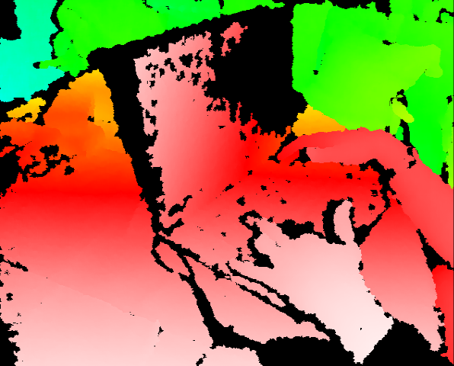
Vision (Perception)
Object and face recognition
Scene segmentation
Image classification
Notes:
FB, Google provide APIs for face/object detection

Slide 22
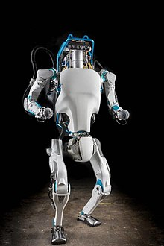
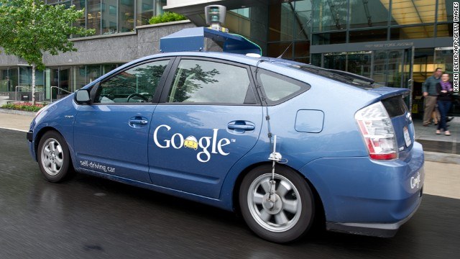
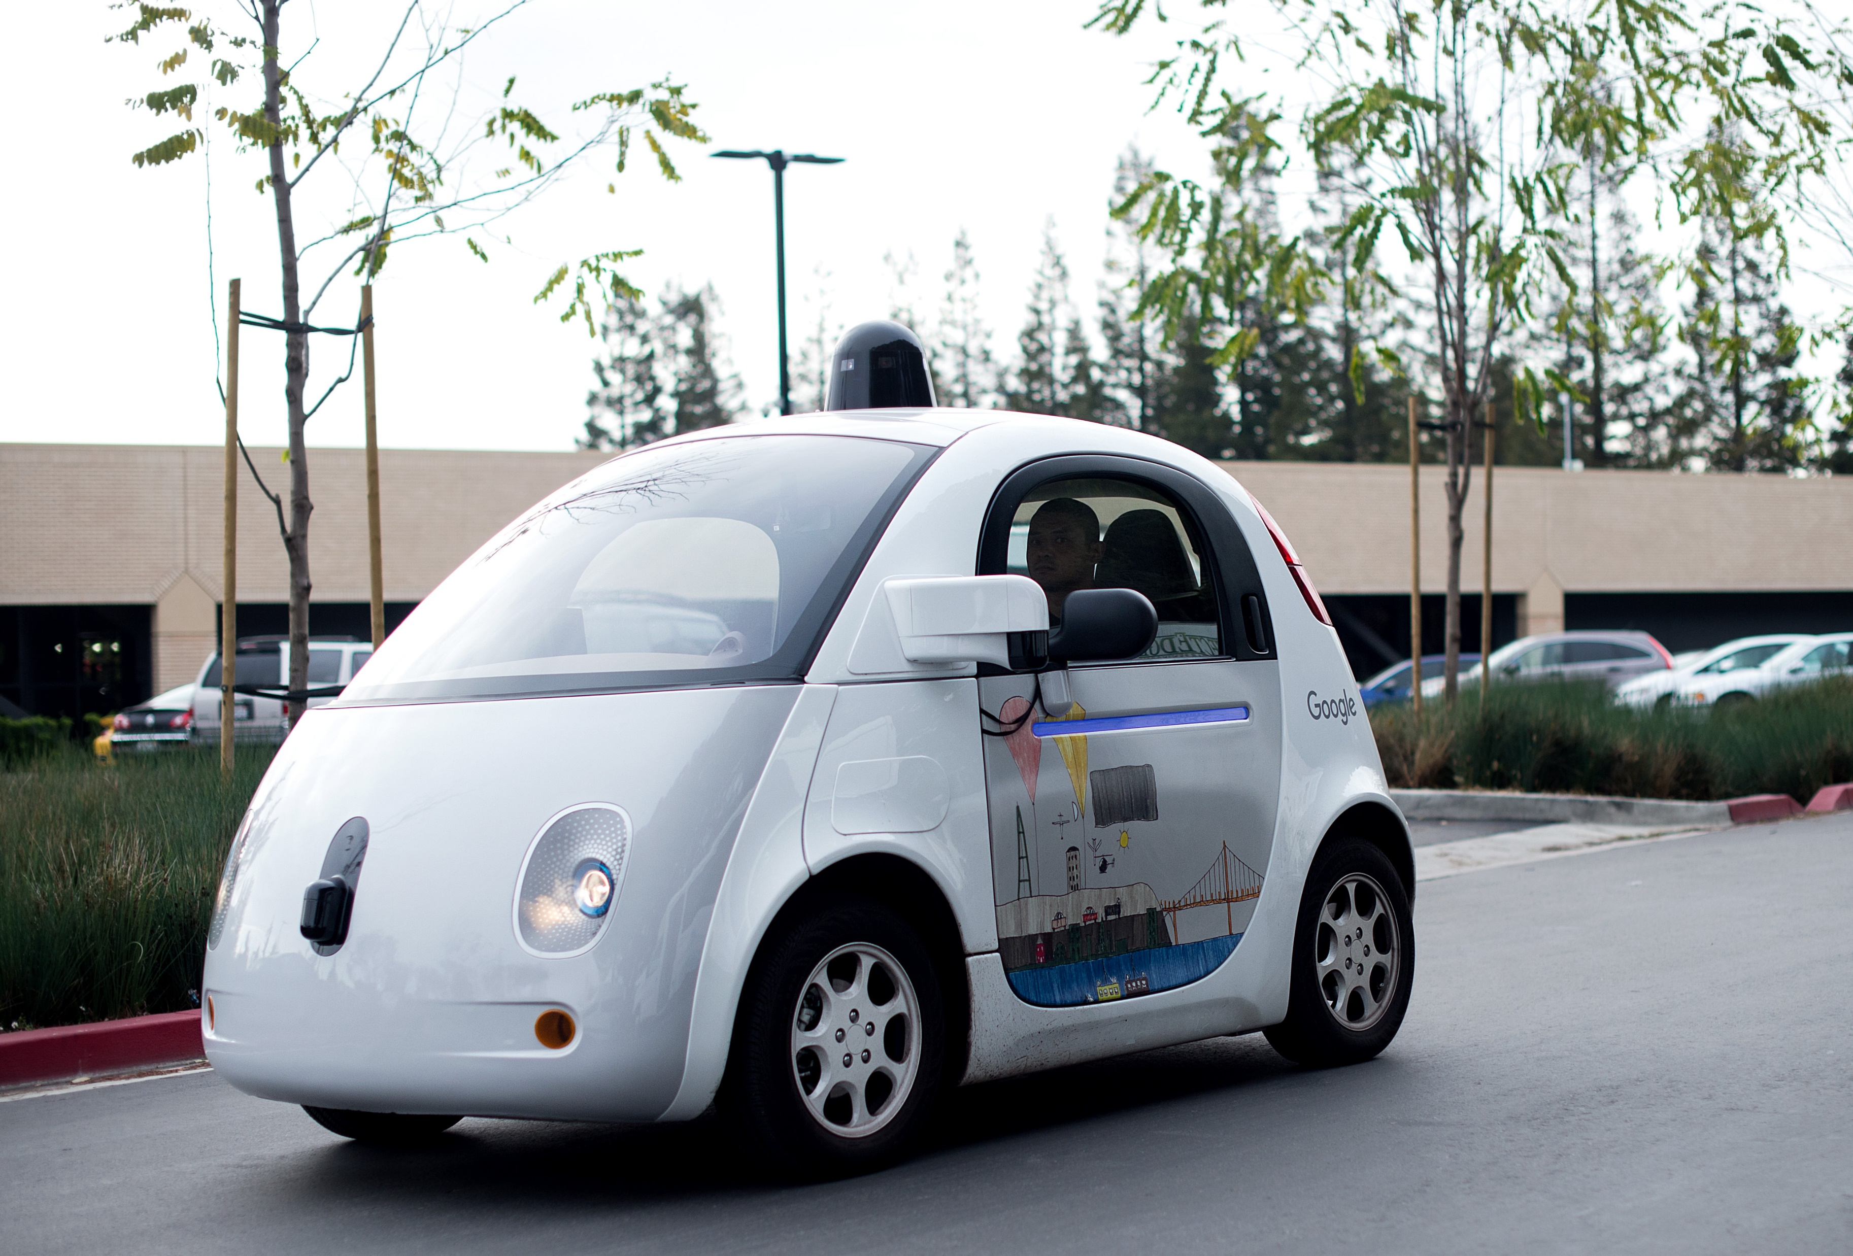
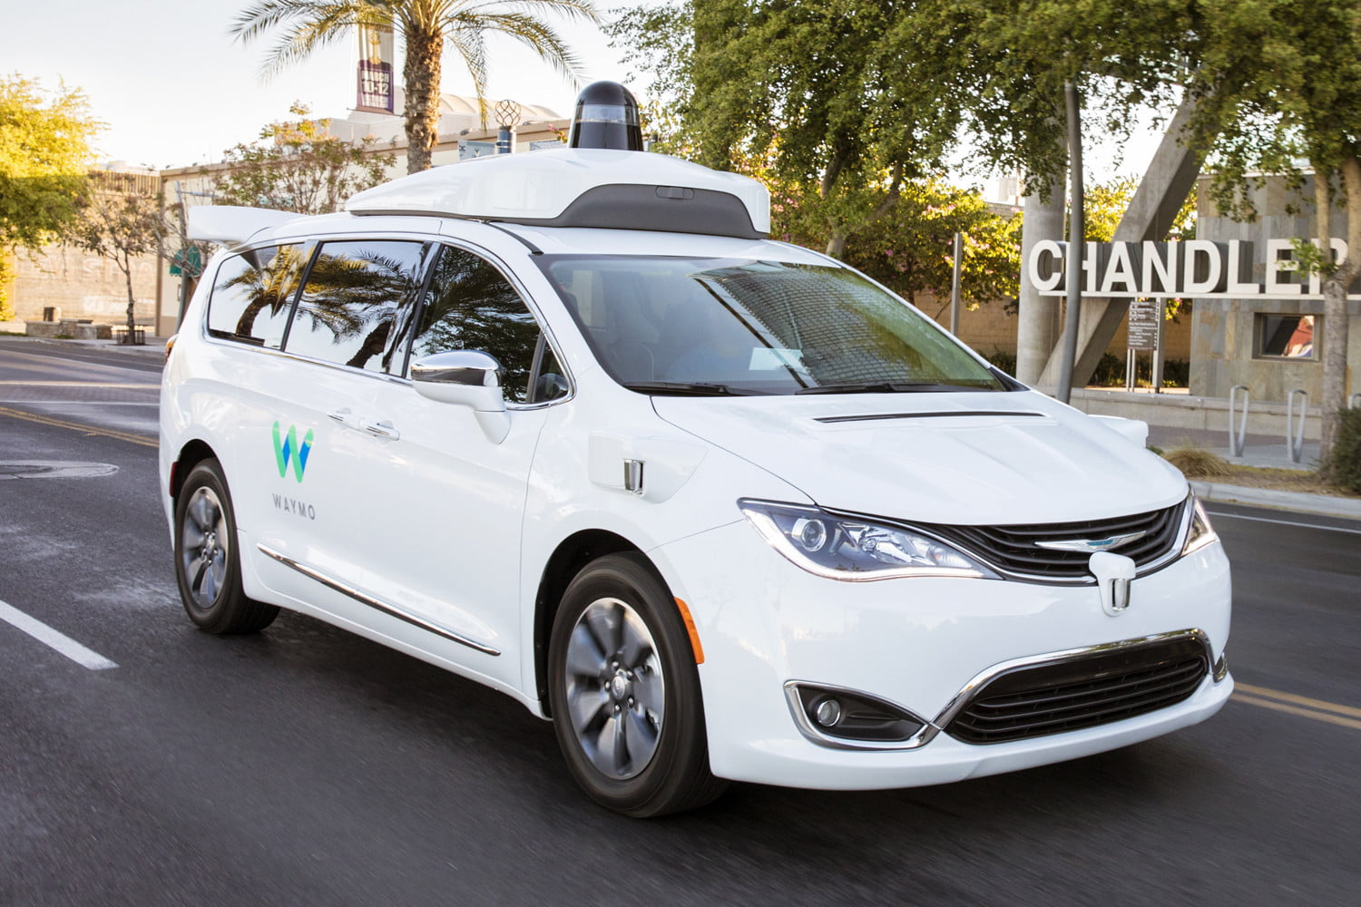
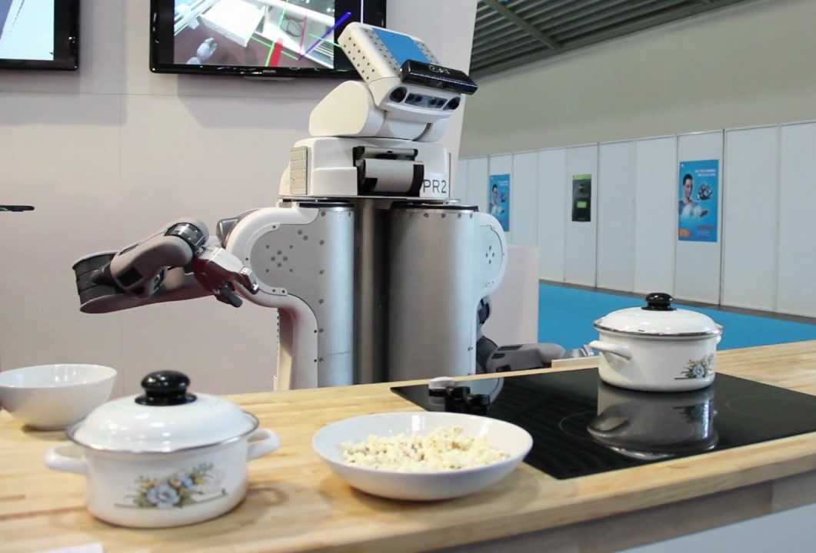
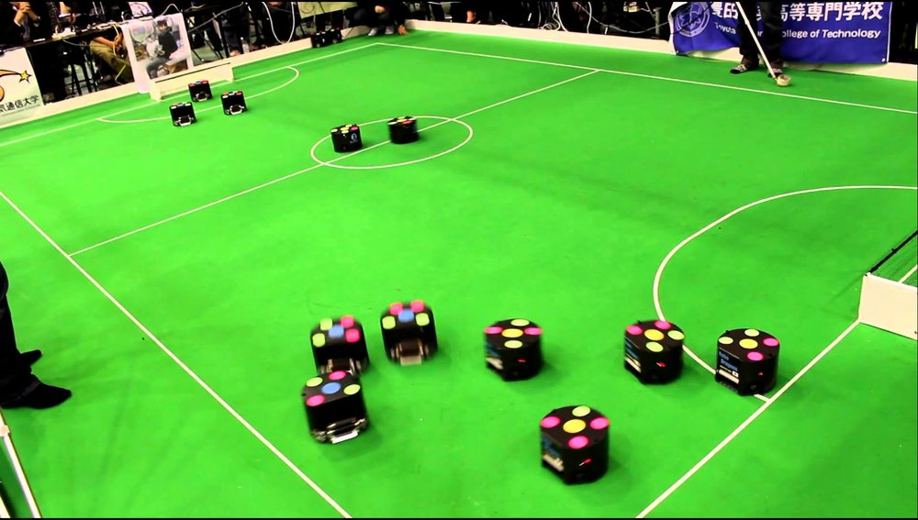
Robotics
Robotics
Part mech. eng.
Part AI
Reality much harder than simulations!
Technologies
Vehicles
Rescue
Soccer!
Baking/cooking
Lots of automation…
In this class:
We ignore mechanical aspects
Methods for planning
Methods for control
Notes:
BostonDynamics Atlas https://www.youtube.com/watch?v=LikxFZZO2sk
BakeBot PR2 https://www.youtube.com/watch?v=CjJH1XSnVVY

Slide 23
Logic
Logical systems
Theorem proving
NASA fault diagnosis
Question answering
Methods:
Deduction systems
Constraint satisfaction
Satisfiability solvers (huge advances!)
Notes:
Theorem proving: https://www.youtube.com/watch?v=OLxbIXwpMes
Jeopardy: https://www.youtube.com/watch?v=P18EdAKuC1U

Slide 24
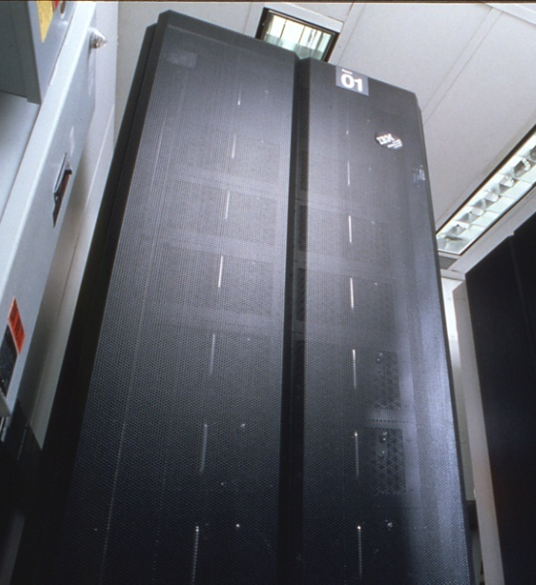
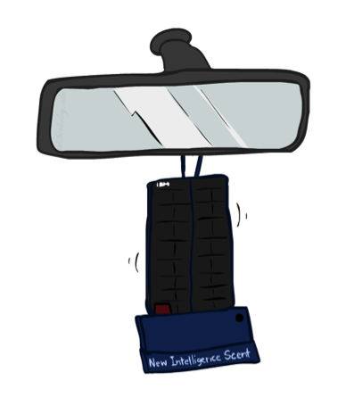
Game Playing
Classic Moment: May, '97: Deep Blue vs. Kasparov
First match won against world champion
“Intelligent creative” play
200 million board positions per second
Humans understood 99.9 of Deep Blue's moves
Can do about the same now with a PC cluster
Open question:
How does human cognition deal with the
search space explosion of chess?
Or: how can humans compete with computers at all??
1996: Kasparov Beats Deep Blue… “I could feel --- I could smell --- a new kind of intelligence across the table.”
1997: Deep Blue Beats Kasparov … “Deep Blue hasn't proven anything.”
Huge game-playing advances recently, e.g. in Go!

Slide 25

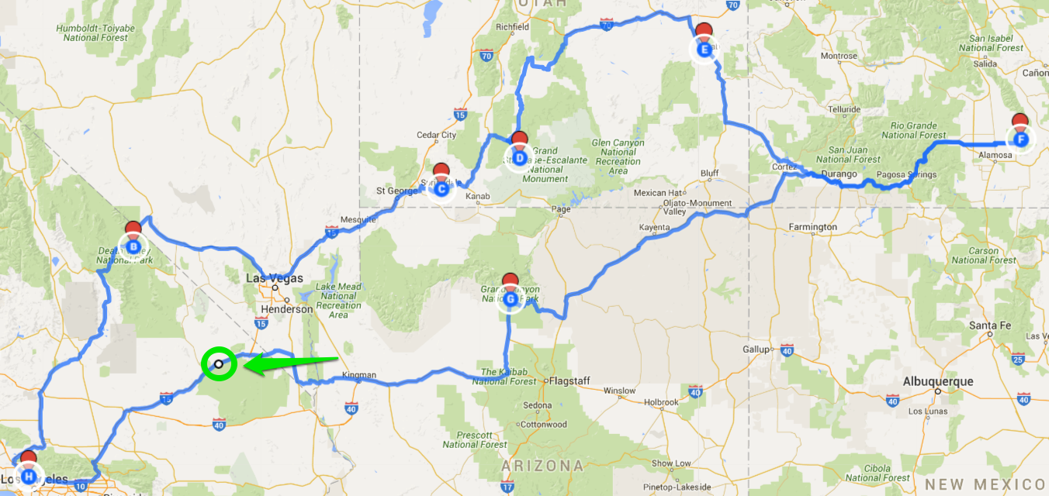
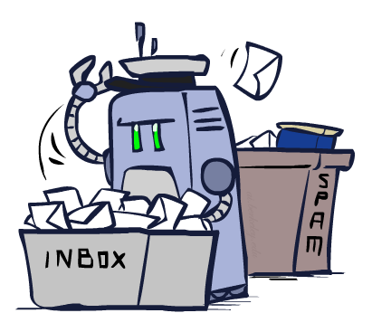

Decision Making
Applied AI involves many kinds of automation
Scheduling, e.g. airline routing, military
Route planning, e.g. Google maps
Medical diagnosis
Web search engines
Spam classifiers
Automated help desks
Fraud detection
Product recommendations
… Lots more!
Notes:
All applications can be thought of as decision making or useful sub-components of decision making.
However, there are often hyped up AI stories in the news… https://www.youtube.com/watch?v=oHtug8l1rtQ

Slide 26
AI overview
Machine Learning
Speech processing
Expert Systems
Natural Language Processing
Unsupervised
Supervised/Semi-supervised
Reinforcement
Artificial Intelligence
Automated Planning, Scheduling
Inference Engine
Knowledge Base
Image recognition
Machine vision
Vision
Robotics
Solving problems by searching
Constraint Satisfaction
Information extraction
Translation
Classification, Clustering
…
…
Notes:
Areas of AI…

Slide 27
Readings
See Canvas

